Slide 1
Building a resilient IaaS architecture
May 2022
Notes:
June 2020

Slide 2
Abstract and learning objectives
In this whiteboard design session, you will look at how to design for converting/extending an existing IaaS deployment for resiliency. Throughout the whiteboard design session, you will look at the various configuration options and services to help build resilient architectures.
At the end of the workshop, you will be better able to design and use resiliency concepts including high availability with Availability Zones, disaster recovery for virtual machines to another region using Azure Site Recovery, and SQL Server high availability and disaster recovery using AlwaysOn Availability Groups. You will also learn how to assess the availability SLA, RPO and RTO of your design, and how to use Azure Backup to protect and secure your SQL data and VMs against corruption and loss.
You will also discuss how to achieve a similar level of resiliency for a PaaS-based implementation the same application, based on Azure App Service and Azure SQL Database. Finally, you will consider the costs associated with both approaches.

Slide 3
Step 1: Review the customer case study
Outcome
Analyze your customer needs.
Timeframe
15 minutes

Slide 4
Customer situation
Contoso Insurance (CI), headquartered in Miami, provides insurance solutions across North America.
Mobile agents located across the US visit claimants to verify their claims and upload information using the Claims Application.
Headquarters is in Miami, Florida with various branch locations.
Notes:
Contoso Inc. manufactures, sells, distributes, and services parts for major appliances and HVAC systems for large corporations and independent firms. The claims application is currently housed in Azure on IaaS SQL server instances. Initially, the claims process was done mainly via phone and expanded to email. Recently, the company has moved to an internet-based claims application with IIS Web Servers in Azure housing the front-end application for the claims, invoicing, and support options.
They have grown into a viable, sustainable business and would like their technology to mirror the growth and sustainability. This would help cement their reputation in the industry and go a long way to assist their future growth. While business impact analysis (BIA) has not officially been performed, they have an overall plan of wanting to restore from an issue within 4 hours and recover to within the last 8 hours if at all possible.
There is no overall IT shop for Contoso Inc. as such. They are pretty much a classic IT company that does not have deep experience in the interactivity of all the
components. They have rolled out sections and departments successfully, but now as the technology matures, they are in need of guidance for their deployments.
Currently, there are 3 branch offices located throughout the U.S. One is in the mid-West, another is on the East Coast and the third is located on the West Coast. Discussions are in progress to grow the business to Europe and a possibility of factories in Mexico and Asia.
Each branch office is small enough that there are no servers housed on-site. Each location has direct connectivity to corporate resources through a VPN connection to the Austin headquarters. Email is accessed via web as is the main claims application.
At times, various branch offices have experienced connectivity issues due to the internet service provider having issues with the corporate office connection. While there is some understanding of these occurrences, there is a desire to provide a way to resolve this as growth continues. Employees work from home when this occurs.

Slide 5
Customer situation - continued
Contoso IT group is a classic shop, mainly focused on infrastructure.
The AppDev department’s skill set is dated, predominantly focused on client/server development.
The organization has an Internet-based claims application they recently deployed into Azure (in West Central US).
The current design relies on a single SQL Server VM and a single AD VM. Web servers use a load-balancer with TCP probe.
Branch offices are connected to Azure using Site-to-Site VPNs with on-site RRAS server.

Slide 6
Customer situation – continued
Customers have reported reliability issues with the claims application. Failures were correlated to service health issues with the SQL VM.
Network connectivity issues between the branch offices and the corporate office have occurred intermittently.
Disk storage has a heightened level of attention due to a critical server running out of disk space, highlighting gaps in proactive monitoring.
Recent stability issues with the claims application prompted Contoso to perform a business impact analysis of the application.
The result is an executive mandate to achieve an SLA of at least 99.95% for the claims application, with RTO of 4 hours and RPO of 6 hours, plus backup of all critical VMs and data.

Slide 7
Customer situation – continued
The App Dev team is working on a next-generation PaaS-based implementation of the claims application.
This is based on a Web App and Azure SQL Database.
The need to achieve a similar level of resilience as the IaaS-based version, otherwise the business will not agree to migrate to PaaS.

Slide 8
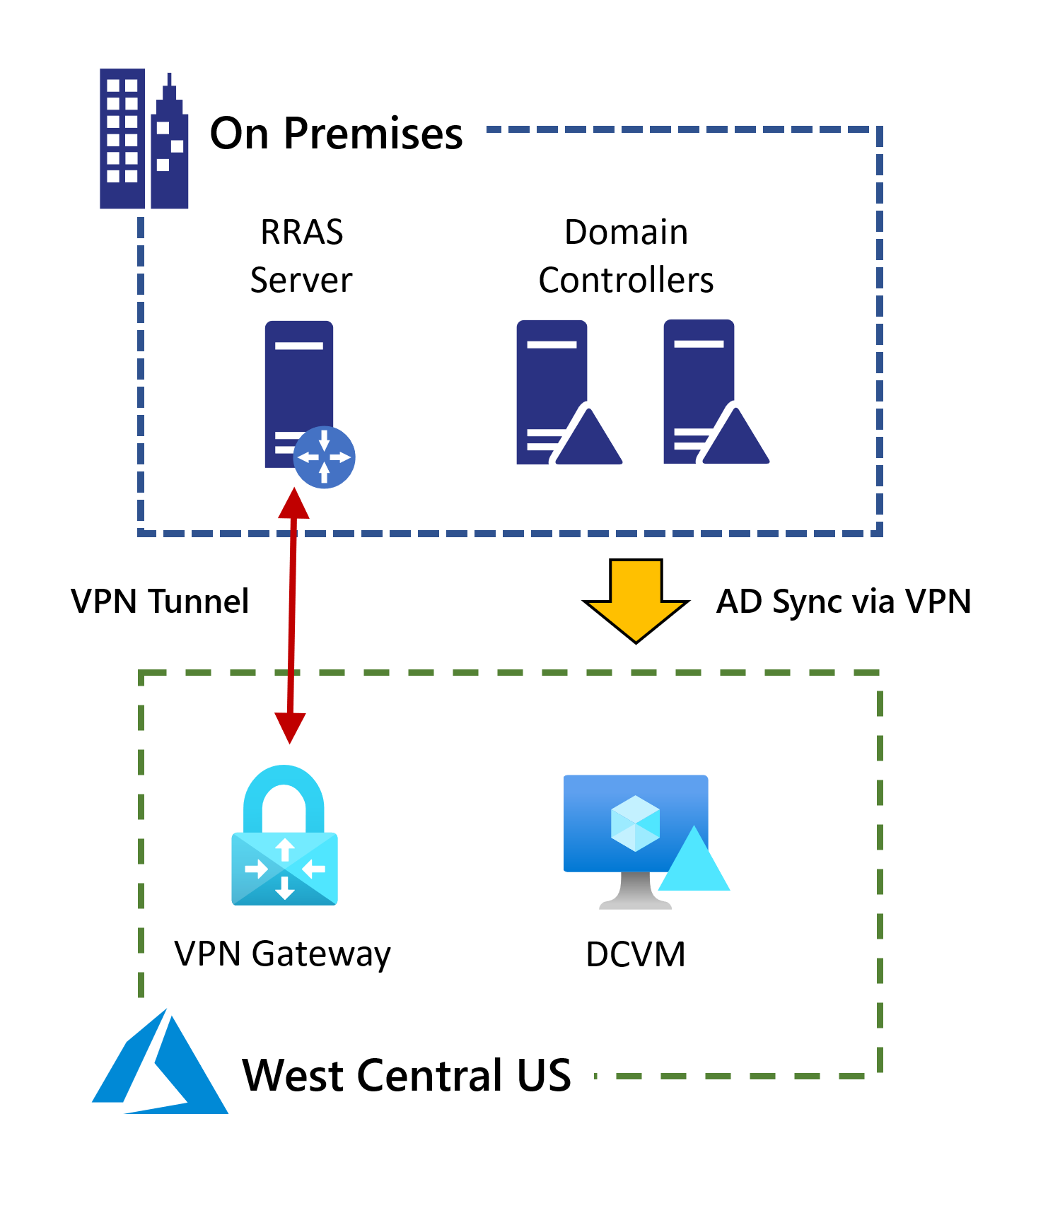
Current Active Directory Configuration
Currently have a single domain controller deployed in west central US
Connectivity is enabled with a site-to-site VPN gateway

Slide 9
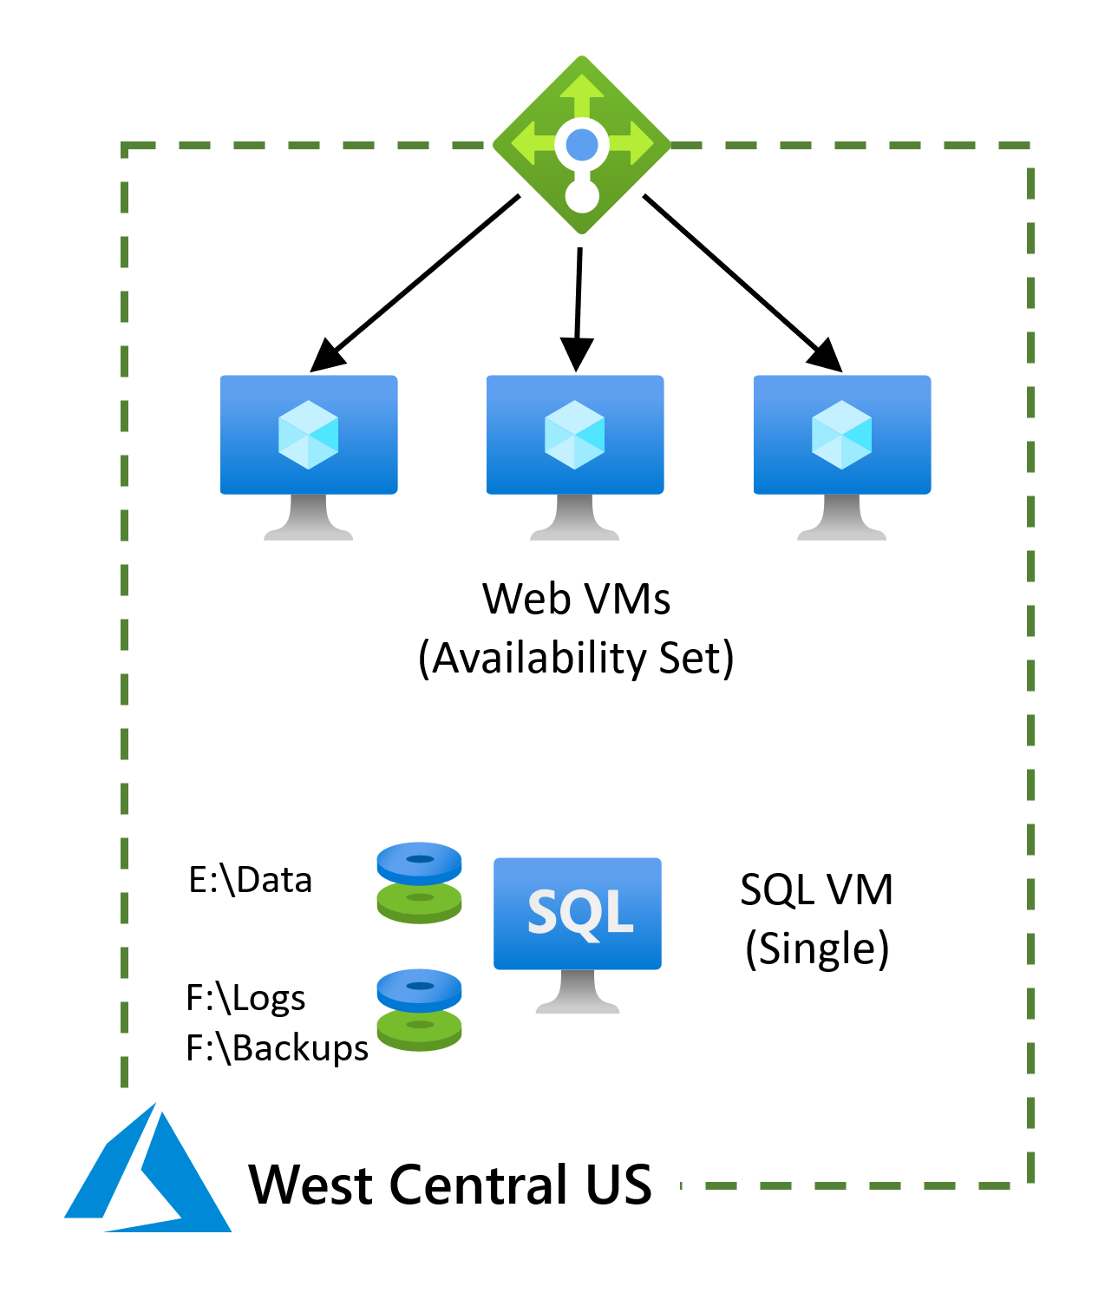
Current configuration for claims application
Web servers deployed into an availability set
SQL Server backend (single VM)
West Central US

Slide 10
Customer needs
Redundancy and resiliency for the AD DS domain controller server, and the web and database servers for the claims application, to deliver the 99.95% or greater SLA required by the business.
Improved reliability for their VPN connections from branch offices.
An automated mechanism for a quick recovery of the claims application in the event of disaster impacting the entire West Central US Azure region.

Slide 11
Customer needs - continued
A plan for recovery from data corruption or accidental deletion for all critical infrastructure components.
A comprehensive solution for monitoring the health of Azure VMs, databases and backups, with proactive alerting of any issues.
An understanding of how to achieve an equivalent level of high availability, disaster recovery and backup for the next-generation PaaS-based implementation of the claims application.
Contoso also want to fully understand the costs associated with each of 1 – 6 above.

Slide 12
Customer objections
Contoso are uncomfortable with any situation that assumes the cloud provider will handle their fail-over.
Contoso want to know their BCDR and backup solutions are secure.
Contoso also want to be able to test both the BCDR and Backup solutions regularly.

Slide 13
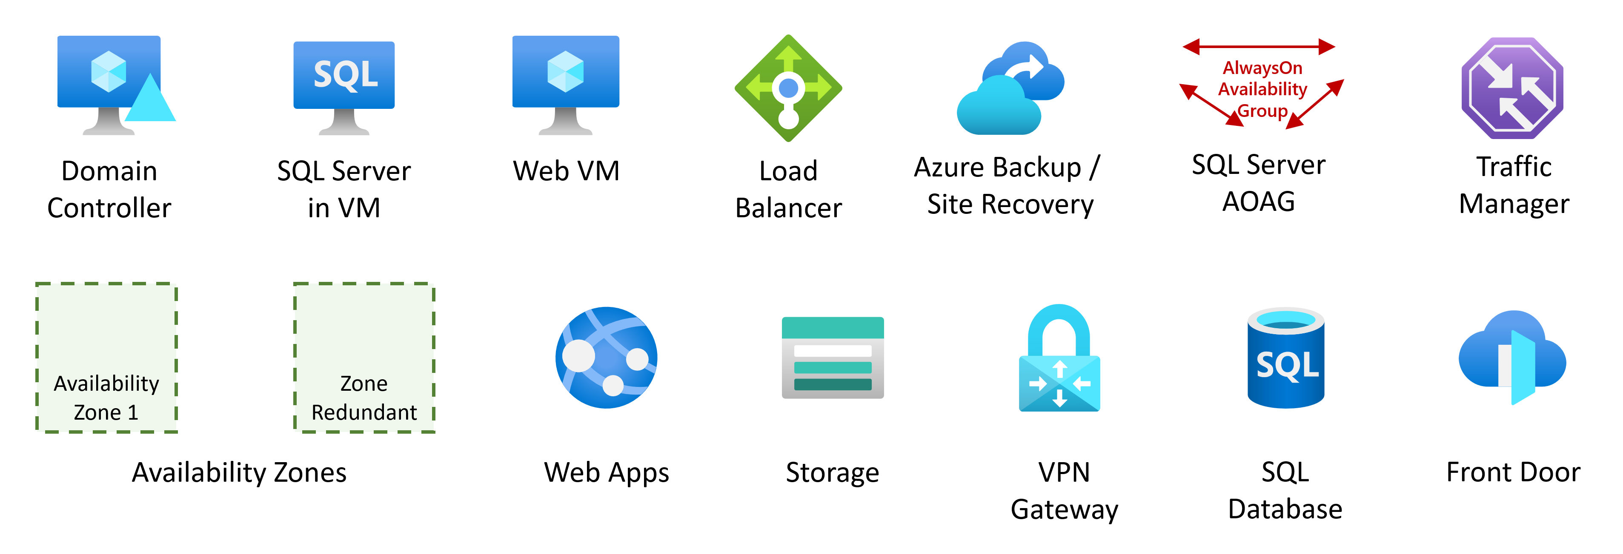
Common scenarios

Slide 14
Step 2: Design the solution
Outcome
Design a solution and prepare to present the solution to the target customer audience in a 15-minute chalk-talk format.
Timeframe
1-2 hours
Business needs | Respond to questions outlined in your student guide and be prepared to present your solution to others.
Design | Design a solution for as many of the requirements in your student guide as time allows.
Pricing | Provide an estimate of the costs associated with each aspect of your solution, following the questions in your student guide.
Prepare | Identify any customer needs that are not addressed with the proposed solution. Identify the benefits of your solution. Determine how you will respond to the customer’s objections. Prepare for a 15-minute presentation to the customer.

Slide 15
Step 3: Present the solution
Outcome
Present a solution to the target customer in a 15-minute chalk-talk format.
Timeframe
30 minutes (15 minutes for each team to present and receive feedback)
Directions
Pair with another team.
One group is the Microsoft team and the other is the customer.
The Microsoft team presents their proposed solution to the customer.
The customer asks one of the objections from the list of objections in the case study.
The Microsoft team responds to the objection.
The customer team gives feedback to the Microsoft team.
Switch roles and repeat Steps 2-6.

Slide 16
Wrap-up
Outcome
Review the preferred solution for the case study.
Timeframe
15 minutes

Slide 17
Preferred target audience
Lewis Franklin, Head of Infrastructure and Operations
Janet Lewis, Business Continuity Team Director
Jordan North, Principal Software Development Lead
You should also aim to identify the business owner of the claims application and the key stakeholders of the business impact analysis that provided the executive mandate for improved resiliency

Slide 18
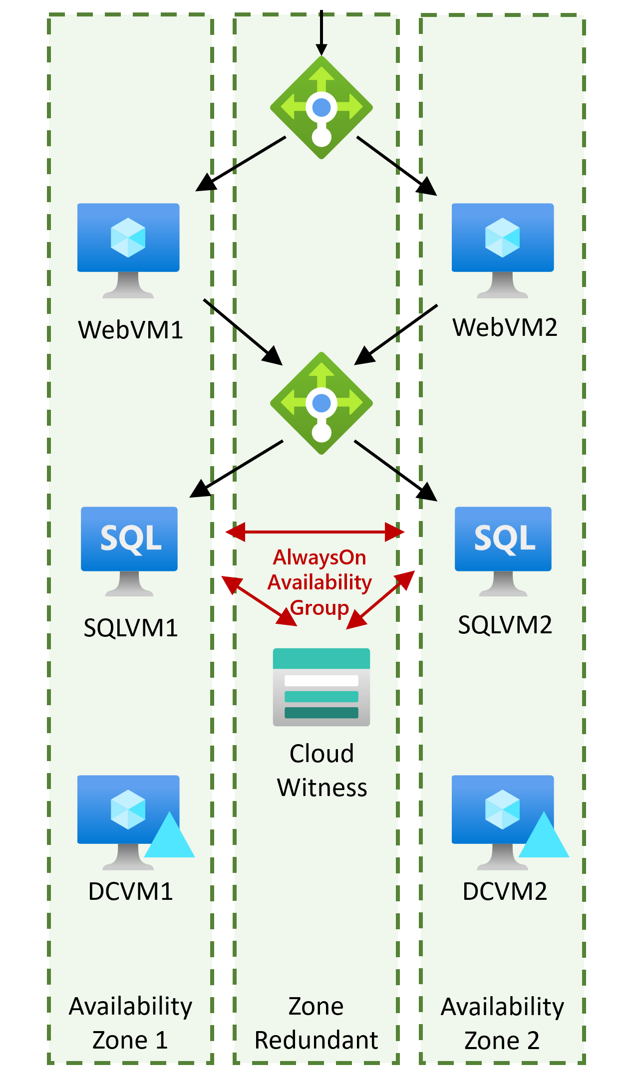
High Availability – Exceed 99.95% SLA
SLA in excess of 99.95% for composite application requires Availability Zones for both Web and SQL tiers
Migrate to a different region e.g. Central US (AZs are not supported in West Central US)
Web tier should use HTTP probe with custom health check page
Optionally, consider using VM Scale Sets for Web tier
SQL Server to use AlwaysOn Availability Groups with cloud witness, synchronous replication, and automatic failover
Deploy two AD servers in separate AZs

Slide 19
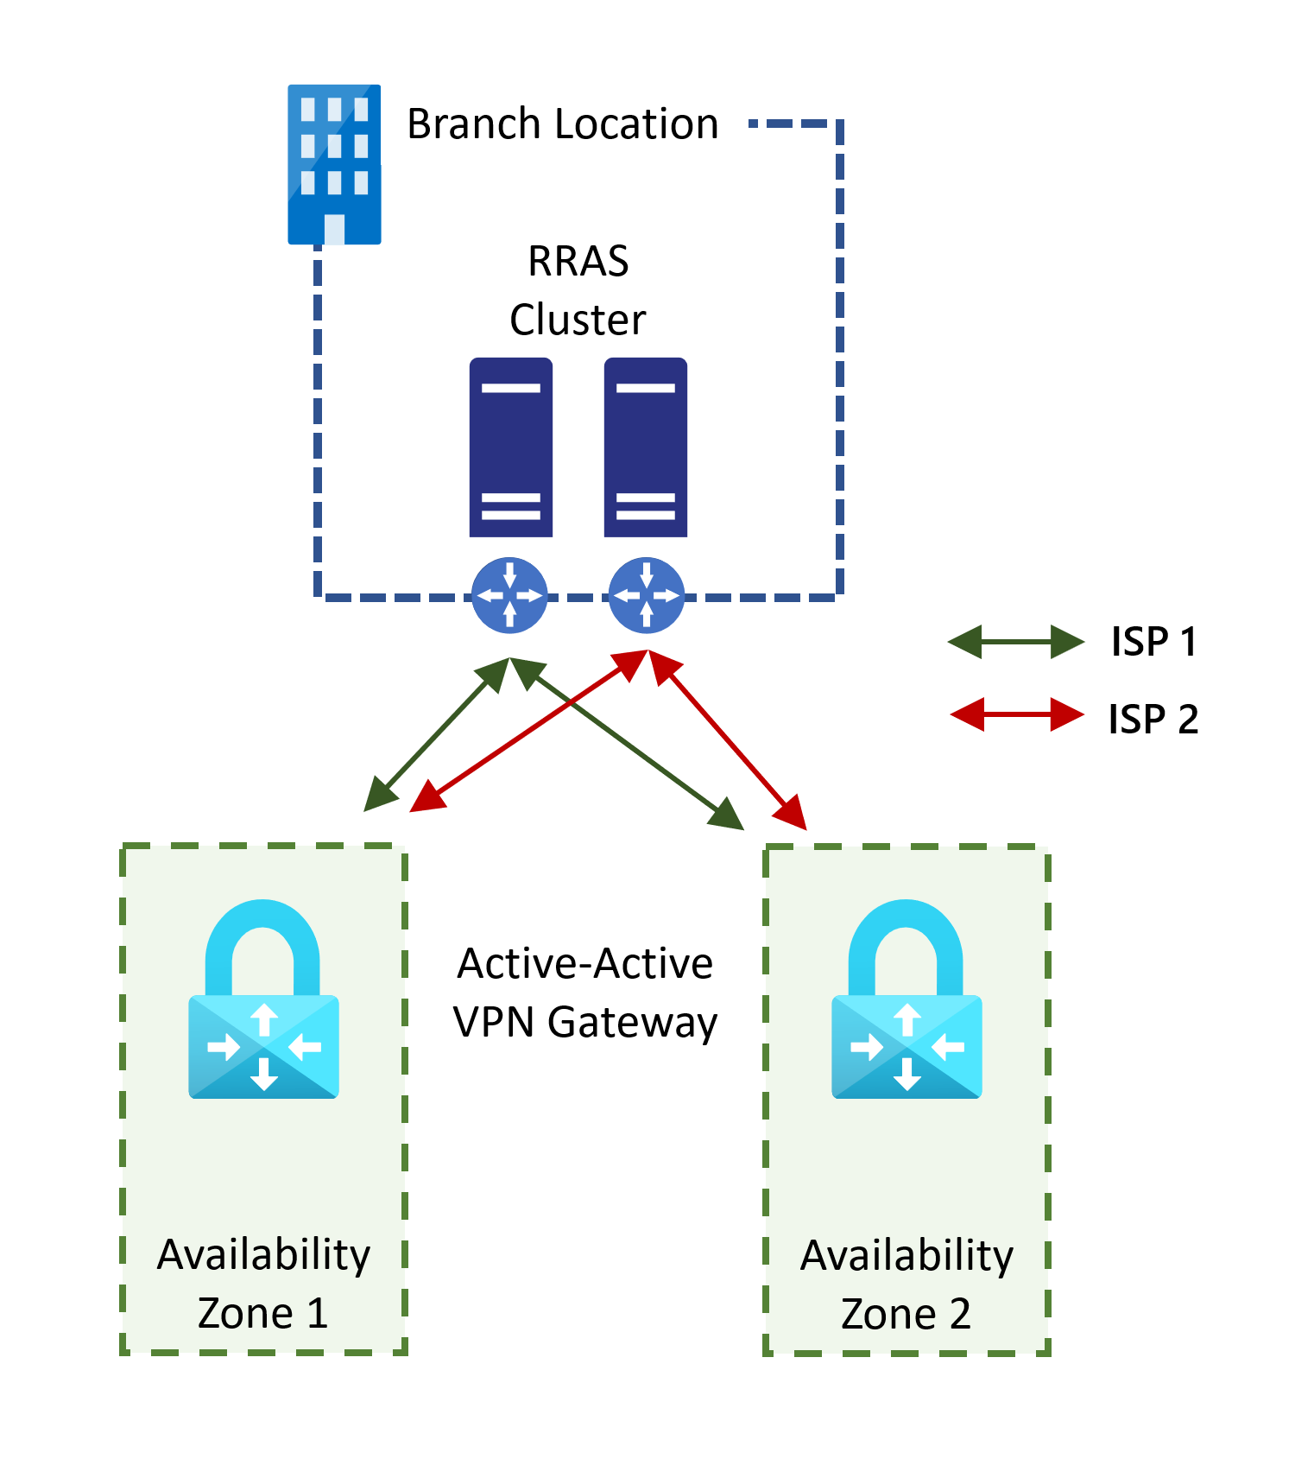
VPN Resiliency
Windows Server clustering for RRAS high availability on-premises
Redundant VPN connections with separate ISPs from each branch office (requires BGP)
Configure Azure VPN Gateway to use Active-Active gateways with AZ support
Notes:
The current VPN has single points of failure at the on-premises VPN gateway (RRAS server), the Azure Virtual Network Gateway, and the ISP connection from the on-premises site to the Internet. All three of these single points of failure can be eliminated.
*On-premises gateway:*
- The RRAS VPN servers can be deployed in a cluster ([here's how](https://docs.microsoft.com/windows-server/remote/remote-access/ras/cluster/deploy-remote-access-in-cluster)). Alternatively, the servers could be upgraded to dedicated hardware VPN devices.
*ISP Internet connection:*
- You need to create multiple S2S VPN connections from each on-premises VPN device to Azure. When you connect multiple VPN devices from the same on-premises network to Azure, you need to create one local network gateway for each VPN device, and one connection from your Azure VPN gateway to the local network gateway.
- The local network gateways corresponding to your VPN devices must have unique public IP addresses in the \"GatewayIpAddress\" property. These IP addresses can be provided by different ISPs.
- BGP is required for this configuration. Each local network gateway representing a VPN device must have a unique BGP peer IP address specified in the \"BgpPeerIpAddress\" property.
- The AddressPrefix property field in each local network gateway must not overlap. You should specify the \"BgpPeerIpAddress\" in /32 CIDR format in the AddressPrefix field.
- You should use BGP to advertise the same prefixes of the same on-premises network prefixes to your Azure VPN gateway, and the traffic will be forwarded through these tunnels simultaneously.
- Each connection is counted against the maximum number of tunnels for your Azure VPN gateway (max 30 for the non-Basic SKUs)
*Azure VPN Gateway:*
- The VPN gateway should be configured for 'active-active' mode rather than the default failover mode.
- An 'Az' SKU should be used to provide protection against failure of individual data centers in the chosen Azure region.

Slide 20
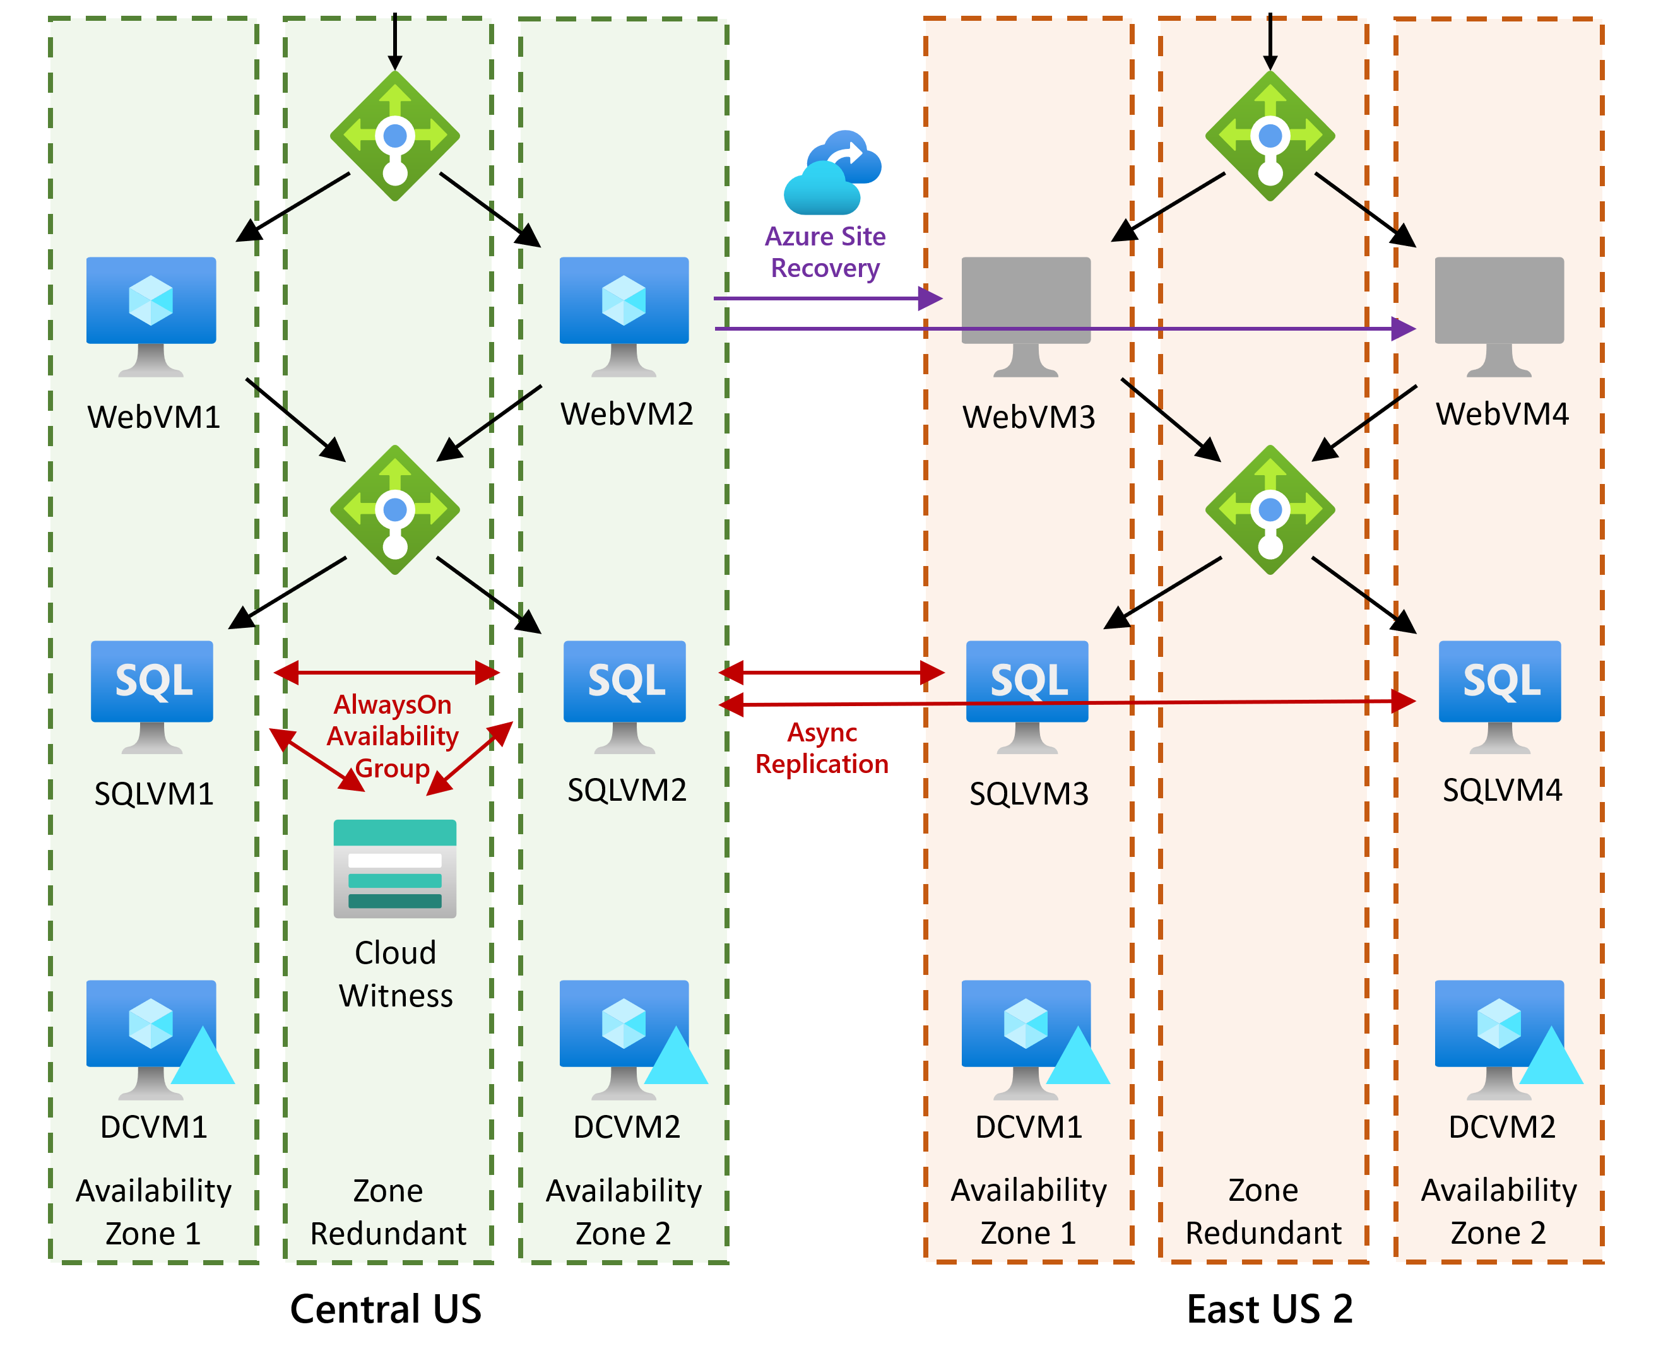
Disaster Recovery
Paired region: East US 2
Web Servers: Use ASR
SQL Servers:
Provisional additional servers in DR region
Asynchronous members of same Availability Group -OR- Separate Availability Group with asynchronous replication between AGs ('distributed Availability Group')
AD: additional pair of VMs (active-active)
VPN: Similar to primary site
Failover
Web VMs handled by ASR
Public endpoint failover: DNS change via ASR custom step, Traffic Manager, or Front Door
SQL 'forced failover', then switch to synchronous replication within DR region
Automation via ASR Recovery Plans and Azure Automation

Slide 21
Backup
Web Tier
Use Azure Backup
Not necessary if stateless
Recovery via file restore or disk restore
SQL Server
Azure Backup for SQL in IaaS
Alternative: SQL Server Managed Backup to Azure Storage
Recover to same DB or alternate location

Slide 22
Monitoring
Web VMs and SQL:
Use Azure Monitor for VMs
Wide range of reports including 'Top N'
Requires Log Analytics Workspace and Log Analytics agent
And Dependency Agent if needed
Option to deploy agents to Azure VMs via policy
Metric-based and log-based alerts (e.g. disk space)
Backup
Backup Explorer
Log Analytics integration
Option to configure Recovery Services Vaults via policy
Log-based alerts (use 'V2' schema)

Slide 23
PaaS Resiliency
High Availability:
Built-in for Web Apps (99.95% SLA)
SQL Database offers 'Standard' or 'Premium' availability based on pricing tier (up to 99.995% SLA)
DR solution:
Deploy Web App to DR region
SQL Database active geo-replication and auto-failover groups (Premium and Business Critical pricing tiers)
Traffic Manager or Front Door for public endpoint failover

Slide 24
Pricing (Infrastructure)
Component | Site | Details/Assumptions | Per Month (USD)
DC VMs | Central US | 2 VMs, Windows, D2s_v3, 1 year reservation, 2x Premium SSD 128 GiB per VM | $314.40
DC VMs | East US 2 | As above | $289.67
VPN Gateway | Central US | VpnGw2AZ, 730 hours, 0 additional tunnels, 100 GB traffic | $419.98
VPN Gateway | East US2 | As above | $419.98
Log Analytics | Central US | 3GB per VM, 180 day retention | $7.08
Log Analytics | East US 2 | As above | $7.08
Alert Rules | Central US | 2 VMs x 10 metrics + 5 log signals @ 5 minutes | $9.50
Alert Rules | East US 2 | As above | $9.50
Total |  |  | $1,477.30
Notes:
Pricing Azure solutions is a complex task. The example solutions include many assumptions, for example on resource size and bandwidth consumed. These need to be validated with Contoso.

Slide 25
Pricing (IaaS Application)
Component | Site | Details/Assumptions | Per Month (USD)
Web VMs | Central US | 2 VMs, Windows, D4s_v3, 1 year reservation, 1x Premium SSD 128 GiB per VM | $510.56
SQL VMs | Central US | 2 VMs, Windows, E4as_v4, 1 year res., SQL Enterprise, 2x Premium SSD 512GiB per VM | $1,906.02
Bandwidth | Central US | 500 GB | $ 43.07
Log Analytics | Central US | 3GB per VM, 180 day retention | $ 27.96
Alert Rules | Central US | 2 VMs x 10 metrics + 5 log signals @ 5 minutes | $ 11.50
VM Backup | Central US | 2x Web VMs, 80GB each, GRS, low churn, 30 daily/26 weekly/24 monthly/3 yearly RPs | $ 54.69
SQL Backup | Central US | 300 GB, GRS, high churn, 30 daily/6 weekly/12 monthly RPs, steady state | $695.28
ASR | East US 2 | 2 instances | $ 50.00
SQL VMs (DR) | East US 2 | 2 VMs, Windows, E4as_v4, 1 year res., SQL Enterprise, 2x Premium SSD 512GiB per VM | $1,613.64
Traffic Manager | Global | 10M DNS queries, 2 endpoints | $ 6.12
VNet | East US 2 | Global peering bandwidth for SQL replication to East US 2, 200GB | $ 14.00
Log Analytics | East US 2 | 3GB per VM, 180 day retention | $ 7.08
Alert Rules | East US 2 | 2 VMs x 10 metrics + 5 log signals @ 5 minutes | $ 9.50
Total |  |  | $4,949.42
Notes:
**Note:**
- SQL Server Enterprise licensing is required for AlwaysOn Availability Groups
- Each SQL Server Enterprise license includes one additional license for a DR server. Hence of the 4 SQL VMs, only 2 need the SQL license. This is a substantial saving.
- Data between Availability Zones in the same region will be billed from Feb 1, 2021

Slide 26
Pricing (PaaS Application)
Component | Site | Details/Assumptions | Per Month (USD)
Web App | Central US | 2 instances, S3 tier | $ 584.00
Web App (DR) | East US 2 | As above | $ 584.00
SQL Database | Central US | Single DB, General Purpose, 4 vCores, PAYG, 2 instances, 500GB. Backup: RA-GRS, 1TB point-in-time, 300GB average backup size, 26 weeks/12 months/3 years retention | $ 1,719.54
SQL Database (DR) | East US 2 | As above, no backup | $ 1,530.25
Traffic Manager | Global | 10M DNS queries, 2 endpoints | $ 6.12
VNet | Central US | Global peering bandwidth for SQL replication to East US 2, 200GB | $ 14.00
Bandwidth | Central US | 500 GB | $ 43.07
App Insights | Central US | 100GB/month, 5 multi-step web tests | $312.20
Alert Rules | Central US | 20 metrics + 10 log signals x 5 minutes | $ 17.00
Total |  |  | $ 4,810.17
Notes:
This compares with a monthly total for the IaaS implementation of **$4,949.42** (excluding infra costs, on the assumption these are still required for other applications).
The PaaS implementation is roughly the same price. However a cost-only comparison does not take into account the considerable additional benefits of a PaaS-based approach, e.g. reduced management overhead. Overall, the PaaS solutions offers significantly better value.

Slide 27
Cost Savings
1 year reserved VM instances included (could extend to 3 years for extra savings)
Does not use Hybrid Benefit (check existing licenses, for both Windows and SQL)
Does not use Log Analytics Capacity Reservation
PaaS solution does not include reservations (a 1-year reservation for the SQL Database would reduce monthly costs, but must be paid up-front)

Slide 28
Customer objections
Objection
Contoso are uncomfortable with any situation that assumes the cloud provider will handle their fail-over.
Potential answer
ASR provides full control over the failover process, including the ability to include custom steps.
For the PaaS implementation, some aspects (such as in-region HA) are handled natively by the platform. Cross-region DR can be managed either manually, or automatically using services such as Traffic Manager and Front Door for the customer endpoint and SQL Database auto-failover groups.

Slide 29
Customer objections
Objection
Contoso want to know their BCDR and backup solutions are secure.
Potential answer
All of the traffic and data used for all Azure BCDR features is secured both at rest and in-transit. As a result, there is no difference in this data and any other data that is running or stored in Azure.

Slide 30
Customer objections
Objection
Contoso also want to be able to test both the BCDR and Backup solutions regularly.
Potential answer
ASR allows for non-disruptive test failovers to validate the failover process.
Backups can be restored to a parallel cloud environment to verify their availability and integrity.

Slide 31
Customer quote
“By using Azure, we can build out resiliency for all aspects of our environment. It allows for infrastructure, networking, web applications, Active Directory, and other items to be redundant and highly available. With some planning and deployment of resilient resources, I envision our LOB apps and websites will no longer be impacted by outages.”
— Lewis Franklin, Head of Infrastructure and Enterprise Operations, Contoso, Inc.

